Slide 1
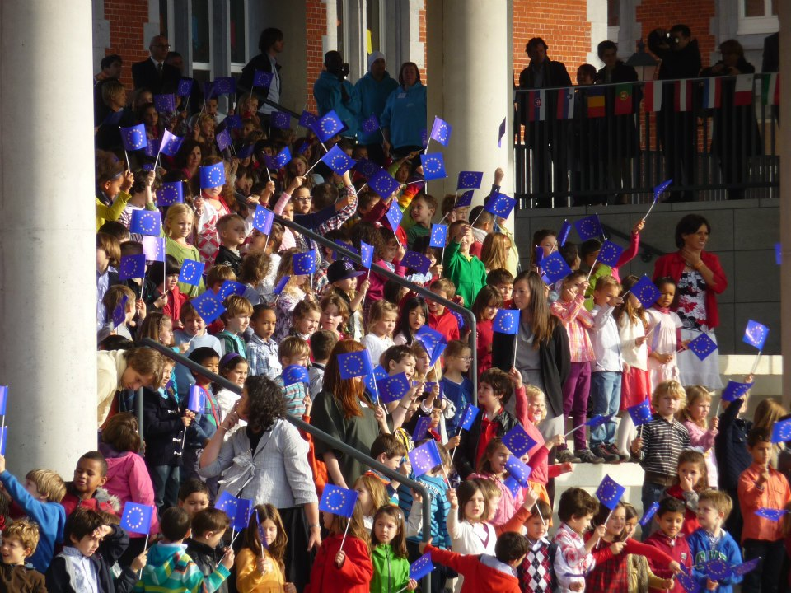

BRUSSE BRUSSELS EUROPEAN SCHOOLS
ADP Meeting on 11 January 2018

Slide 2

EDUCATIONAL PROJECT

Slide 3
What is the structure of the European Schools?
Cycle | Classes | Age
Early education (Nursery) | 1 - 2 | 4 and 5
Primary | 1 - 5 | 6 - 10
Secondary Observation cycle Pre-specialisation cycle Specialisation cycle | 1 - 3 4 - 5 6 - 7 | 11 - 13 14 - 15 16 - 18
European Baccalaureate
Educational Support
Special Educational Needs (Educational Support)
SWALS = Students Without A Language Section

Slide 4
Educational principles of European Schools
Basic instruction is given in the official languages of the European Union. This principle allows the primacy of the pupil’s mother tongue/dominant language (L1) to be safeguarded.
Consequently, each school comprises several language sections. The curricula and syllabuses (except in the case of mother tongue) are the same in all sections.
Also to foster the unity of the school and encourage genuine multi-cultural education, there is a strong emphasis on the learning, understanding and use of foreign languages. This is developed in a variety of ways

Slide 5
Who defines the pedagogical project?
COMPLAINTS BOARD
BOARD OF GOVERNORS
TROIKA
JOINT TEACHING COMMITTEE
GENERAL SECRETARIAT
Secretary-General and DSG
Baccalaureate Unit
BOARDS OF INSPECTORS
Nursery-Primary
Secondary
Joint
BUDGETARY
COMMITTEE
EUROPEAN SCHOOLING
13 European
Schools
12 Accredited European
Schools

Slide 6
Mission statement
The European Schools are official educational establishments controlled jointly by the governments of the Member States of the European Union. In all these countries they are legally regarded as public institutions.
The mission of the European Schools is to provide high quality multilingual and multicultural education for nursery, primary and secondary level pupils.

Slide 7
13 SCHOOLS IN 6 COUNTRIES
School | Country | Year | First BAC
Luxembourg 1 | Luxembourg | 1953 | 1959
Brussels 1 | Belgium | 1958 | 1964
Mol | Belgium | 1960 | 1966
Varese | Italy | 1960 | 1965
Karlsruhe | Germany | 1962 | 1968
Bergen | The Netherlands | 1963 | 1971
Brussels 2 | Belgium | 1974 | 1982
Munich | Germany | 1977 | 1984
Brussels 3 | Belgium | 1999 | 2001
Alicante | Spain | 2002 | 2006
Frankfurt | Germany | 2002 | 2006
Luxembourg 2 | Luxembourg | 2004 | 2013
Brussels 4 | Belgium | 2007 | 2017

Slide 8
What is the content of the curricula?
Does it differ depending on the language section?
Cycle | Level | AGE | Language section
Upper secondary | s7 | 18 | L1 | Choices |  | L2
 | s6 | 17
Lower Secondary | s5 | 15 |  | L4? | L3 | ECO | L2
 | s4 | 14
 | s3 | 13 | L1, Math, Sci, Hum Sci |  |  | Hi, Geo, Rel
 | s2 | 12 |  |  |  | Art & Mus
 | s1 | 11
Primary | p5 | 10 |  |  |  | European
 | p4 | 9 |  |  |  | Hours
 | p3 | 8 | L1, Math, Disc Word, mus, art PE
 | p2 | 7
 | p1 | 6
Early education | n2 | 5 | L1
 | n1 | 4

Slide 9
Cycle | Level | AGE | SWALS
Upper secondary | s7 | 18 | L2 | Choices |  |  | L1
 | s6 | 17
Lower Secondary | s5 | 15 |  | L4 | L3 | ECO | L1
 | s4 | 14
 | s3 | 13 | L2, Math, Sci, Hum Sci |  |  | Hi, Geo, Rel
 | s2 | 12 |  |  |  | Art & Mus
 | s1 | 11
Primary | p5 | 10 |  |  |  | European
 | p4 | 9 |  |  |  | Hours
 | p3 | 8 | L2, Math, Disc Word, mus, art, PE
 | p2 | 7
 | p1 | 6
Early education | n2 | 5 | L2 |  |  |  | L1
 | n1 | 999

Slide 10
Teaching of Languages in the EE
All the mother tongues of 28 countries + Maltese and Gaelic are taught (24 official; 23 as L1)
Schools have 6-8 language sections
Students without language sections= SWALS
L2: English, French, German
  (European Hours in primary)
  History, Geography, Economy, Religion, Ethics in L2 in Secondary
  Art, Music, Sport etc. are taught in one of the L2 or HCL in Secondary
L2 starts at 1st primary
L3 starts at 1st secondary
L4 can start at 4th secondary (optional)
L5 = Complementary course secondary 6-7
+ Latin (s2-) and ancient Greek (s4-)

Slide 11
LANGUAGE REFERENCE TABLE based on European Framework of Reference for Languages
BASIC PROFIENCY LEVEL IN DIFFERENT CYCLES
 | Early education | Primary | Secondary 3 | Secondary 5 | Secondary 7
L2 | 0 | A2 | B1 | B2 | C1
L3 | 0 | 0 | A1+ | A2+ | B1+
L4 | 0 | 0 | 0 | A1 | A2+
ONL | A 1.1 oral | A 1.2 | A2 | B1 | B2

Slide 12
European Baccalaureate
The secondary school course is validated by the European Baccalaureate examinations at the end of the seventh class secondary.
The awarded diploma is fully recognised in all the countries of the European Union, as well as in a number of others. “Those awarded the diploma have the same rights and benefits, as other holders of equivalent qualifications in their countries, to seek admission to any university or institution of higher education in the European Union”.

Slide 13
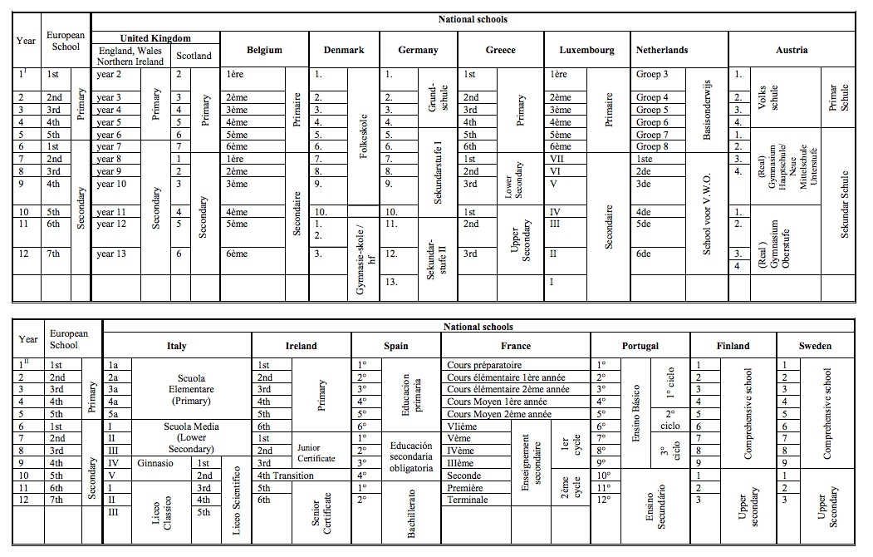
Table of equivalences of teaching levels/year groups

Slide 14
ONL (Other National Language)
Educational Support
Special Educational Needs
What about pupils who do not aim at European Baccalaureate?
14

Slide 15
The educational players of the European Schools
The European Baccalaureate
Seconded teachers
Locally recruited teachers
School management’s role
Inspectors’ role
15

Slide 16
ENROLMENT

Slide 17
What is the Central Enrolment Authority/CEA (Autorité Centrale des Inscriptions/ACI) and what are its tasks?
Who and on what basis decides on the distribution of pupils/applications in the different schools/sites?
The CEA is the administrative authority competent to take decisions on applications for enrolment at and transfers between the Brussels European Schools, in accordance with the provisions of the current Enrolment Policy.
The details of its composition, the procedures governing its operation and its tasks are the subject of a set of Rules of Procedure (2016-11-D-25-en-3), which can be consulted on
www.eursc.eu under Basic Texts
For the 2018-2019 school year, the Policy on Enrolment in the Brussels European Schools (2017-12-D-5-en-3) can be consulted on
www.eursc.eu under Enrolments

Slide 18

The different school/sites
ENROLMENT

Slide 19
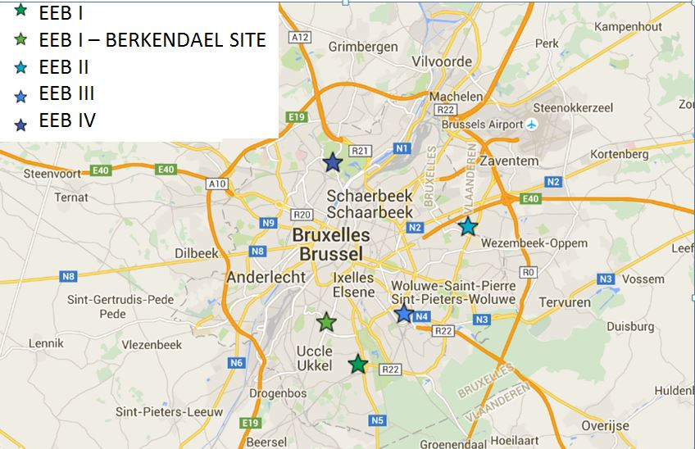
European Schools/Sites in Brussels
Brussels I – Uccle Site (EEB1 - UCC Site)
Brussels I – Berkendael Site (EEB1 - BK Site)
Brussels II (EEB2)
Brussels III (EEB3)
Brussels IV (EEB4)
EEB4
EEB2
EEB3
EEB1 – BK Site
EEB1 – UCC Site
19

Slide 20
Pupil population of the Brussels European Schools

Slide 21
What language sections exist in which school/site today?
EEB1 - UCC Site
Nursery | DA | DE | EN | ES | FR | HU | IT | PL
Primary | DA | DE | EN | ES | FR | HU | IT | PL
Secondary | DA | DE | EN | ES | FR | HU | IT | PL
EEB1 - BK Site |  |  |  |  | Classes
Nursery | FR | LV | SK |  | DE
Primary | FR | LV | SK |  | DE P1 → P3
EEB2
Nursery | DE | EN | FI | FR | IT | LT | NL | PT | SV
Primary | DE | EN | FI | FR | IT | LT | NL | PT | SV
Secondary | DE | EN | FI | FR | IT | LT S1 → S4 | NL | PT | SV
EEB3
Nursery | CS | DE | EL | EN | ES | FR | NL
Primary | CS | DE | EL | EN | ES | FR | NL
Secondary | CS | DE | EL | EN | ES | FR | NL
EEB4
Nursery | BG | DE | EN | ET | FR | IT | NL | RO
Primary | BG | DE | EN | ET P1 → P2 | FR | IT | NL | RO
Secondary | BG S1 → S2 | DE | EN | - | FR | IT | NL | RO S1
+ at EEB1 – BK Site : new satellite classes
21

Slide 22
Distribution of SWALS by school in Brussels
EEB1 - UCC Site
Nursery | SL | MT
Primary | SL | MT
Secondary | SL | MT
EEB2
Nursery | ET * | - | LV *
Primary | ET * | - | LV *
Secondary | ET * | LT S5 → S7 | LV
EEB3
Nursery | SK *
Primary | SK *
Secondary | SK
EEB4
Nursery | - | - | HR | -
Primary | - | ET P3 → P5 | HR | -
Secondary | BG S3 → S7 | ET | HR | RO S2 → S7
* regrouping of siblings only
22

Slide 23
The European School, Brussels I – Berkendael Site
All schools/sites offer all-through schooling from the Nursery cycle to the European Baccalaureate.
During its meeting of 1-3 December 2015, the Board of Governors approved temporary use of the Berkendael site as an extension to the European School, Brussels I pending opening of the European School, Brussels V.
The Berkendael Site accommodates the nursery and primary cycles in their entirety.
In September 2017:
- nursery and primary cycles in the FR section,
- nursery cycle in the SK and LV sections,
- satellite German classes from nursery cycle to primary year 2.
In September 2018:
- nursery and primary cycles in the FR, SK and LV sections,
- satellite German classes from nursery to primary year 3,
- new satellite classes.
23

Slide 24
Open Days/Information Sessions
The Brussels European Schools organise Open Days/Information Sessions for new parents.
Full information is available on the Schools’ websites:
www.eeb1.com
www.eeb2.eu
www.eeb3.eu
www.eeb4.be
 | Nursery and Primary
EEB1 – BK Site | 24/01/18 from 1:00 pm to 2:30 pm 07/03/18 from 1:00 pm to 2:30 pm 16/05/18 from 1:00 pm to 2:30 pm
EEB1 – UCC Site | 24/01/18 pm (also for Secondary)
EEB2 | 22/01/18 from 5:30 pm to 7:30 pm
 | 14/05/18 from 11:00 am to 1:00 pm
EEB3 | 21/02/18 from 9:00 am to 10:45 am (+ Secondary from 1:00 pm)
EEB4 | 07/02/18 afternoon (also for Secondary) 25/04/18 afternoon (also for Secondary)
24

Slide 25
APPLICATIONS
ENROLMENT

Slide 26
How, when and at what age should an application for enrolment be submitted?
2018-2019 Enrolment form
- available: - from the intranet of each institution
- on request, from the enrolment secretariat of each school.
- to be handed in or sent to the school/site corresponding to the first preference expressed on the enrolment form.
2 enrolment phases
  1st enrolment phase: from 11 to 30 January 2018
  2nd enrolment phase: from 19 February to 15 June 2018
  and from 2 July to 4 September 2018
For category I pupils whose parent is in post on 31 December 2017: submission of the application during the FIRST phase is mandatory.
For category I pupils whose parent is taking up his/her post as from 1 January 2018: submission of the application during the FIRST or SECOND PHASE.
26

Slide 27
Age requirement
Nursery school: pupils will be admitted at the beginning of the school year in September of the calendar year in which the child reaches 4 years of age.
(= children born in 2014)
Primary year 1: pupils will be admitted at the beginning of the school year in September of the calendar year in which the child reaches 6 years of age.
(= children born in 2012)
Pupils who are already attending one of the Brussels European Schools/sites during the 2017/2018 school year – regardless of their cycle - will automatically be enrolled for the 2018/2019 school year. No NEW application for enrolment should be submitted. The school will automatically consult the parents regarding the optional subjects.
The legal representative of pupils in P5 at the European School, Brussels I – Berkendael Site during the 2017/2018 school year, will be required to submit, during the first phase, a transfer application to continue their schooling in the secondary cycle at the European Schools, Brussels I – Uccle Site, Brussels II, Brussels III or Brussels IV.
Les

Slide 28
- How should the language section be chosen? Who makes this choice in the event of doubts about the child's dominant language?
- What can parents do if they contest this choice, lodge an appeal?
Article 47(e) of the General Rules of the European Schools (2014-03-D-14-en-5),
Articles 2.14. and 2.15. of the 2018-2019 Enrolment Policy
A contentious appeal against the pedagogical decision taken by the school, together with the CEA’s decision on award of a place in one or other of the schools, may be lodged with the Complaints Board of the European Schools.
28

Slide 29
Article 47 (e) of the General Rules of the European Schools
“A fundamental principle of the European Schools is the teaching of mother tongue /dominant language as first language (L1). This principle implies the pupil’s enrolment in the section of his/her mother tongue/ dominant language where such a section exists.
- This principle may be waived only where the child has been educated in a language other than his/her mother tongue/dominant language for a minimum of two years at primary or secondary level. The European Schools will presume in that case that the child will be capable of continuing his/her schooling in the language in question.
- In schools where the section corresponding to a pupil’s mother tongue/dominant language does not exist, he/she will generally be enrolled in one of the vehicular language sections. He/She will attend the classes in his/her mother tongue/ dominant language organised for so-called SWALS (Students Without A Language Section) as L1.
- Parents will not be free to choose their child’s first language (L1), its determination being the responsibility of the school’s Director L1 must correspond to the child’s mother tongue or dominant language, in the case of multilingual children, the dominant language being the one of which they have the best command.
- Should there be any dispute about the pupil’s L1, it will be the Director’s responsibility to determine which language it is, on the basis of the information provided by the pupils’ legal representatives on the enrolment form and by requiring the pupil to take comparative language tests, organised and under the control of the school’s teachers. The tests will be organised whatever the pupil’s age and teaching level, i.e. including the nursery cycle.
Determination of L1 at the time of the child’s enrolment is definitive in principle (…).”
29

Slide 30
From the Institute of Education, London Report
”It is important to note that students are likely to transfer L1 skills to their L2 and L3. The greater a student’s L1 proficiency, the greater his or her meta-linguistic awareness, and the better his or her L1 language learning habits and skills, the more likely it is that this proficiency, metalinguistic awareness and these language learning habits and skills will support learning of the L2 and the L3 and through the L2 and L3.”
30

Slide 31
What is the content of the curricula?
Does it differ depending on the language section?
Cycle | Level | AGE | Language section
Upper secondary | s7 | 18 | L1 | Choices |  | L2
 | s6 | 17
Lower Secondary | s5 | 15 |  | L4? | L3 | ECO | L2
 | s4 | 14
 | s3 | 13 | L1, Math, Sci, Hum Sci |  |  | Hi, Geo, Rel
 | s2 | 12 |  |  |  | Art & Mus
 | s1 | 11
Primary | p5 | 10 |  |  |  | European
 | p4 | 9 |  |  |  | Hours
 | p3 | 8 | L1, Math, Disc Word, mus, art PE
 | p2 | 7
 | p1 | 6
Early education | n2 | 5 | L1
 | n1 | 4

Slide 32
LANGUAGE REFERENCE TABLE based on European Framework of Reference for Languages
BASIC PROFIENCY LEVEL IN DIFFERENT CYCLES
 | Early education | Primary | Secondary 3 | Secondary 5 | Secondary 7
L2 | 0 | A2 | B1 | B2 | C1
L3 | 0 | 0 | A1+ | A2+ | B1+
L4 | 0 | 0 | 0 | A1 | A2+
ONL | A 1.1 oral | A 1.2 | A2 | B1 | B2

Slide 33
To which school/site should the application be submitted ?
Order of preference
  The applicant will be invited to express an order of preference of the schools/sites, numbered from 1 to 5 (for the nursery/primary cycles) and 1 to 4 (for the secondary cycle), of which account will be taken as far as reasonably possible, without prejudice to application of the general enrolment rules.
  The applicant will hand in or send the enrolment application to the Brussels school/site corresponding to the first preference expressed on the enrolment form.
  The order of preference must be identical for joint applications.
  An application for the enrolment of each sibling must be submitted.
33

Slide 34
The European School, Brussels I – Berkendael Site
In view of the infrastructure currently made available and of the need to contain the overcrowding, filling the Berkendael site, which still has more than 650 unused places, is a priority for the 2018-2019 enrolment campaign:
Enrolment application expressing a first preference for EEB1 – BK Site will be dealt with first and foremost.
Transfer to EEB1 – BK Site will be allowed during the two enrolment phases and without any condition other than the submission of an application.
If classes need to be created, the CEA will give priority consideration to locating them at EEB1 – BK Site. Once there are a minimum of 7 pupils in the nursery cycle (N1+N2) and 7 pupils per year group in the primary cycle, the CEA can open a satellite class at EEB1 – BK Site, except for pupils belonging to single language sections which are in the process of being set up (BG, ET and RO), Croatian and Slovenian SWALS and Maltese pupils.

Slide 35
AWARD of places
ENROLMENT

Slide 36
Are all enrolment applications accepted?
Category I pupils – applications for enrolment in a multiple language section (present in several schools/sites)* –:
are entitled to attend one of the European Schools/sites in accordance with the general enrolment rules, i.e. not necessarily their first preference school/site,
unless the existence of a special priority criterion, within the meaning of Article 8 of the Enrolment Policy, can be demonstrated.
* Should the creation of satellite classes involve a Language 1 which had classes at only one of the other four schools/sites (single language section), the language section will then be treated as a multiple section.
However, in view of the growth in the pupil population and of the infrastructure made available to the European Schools, the CEA is not in a position to be able to guarantee the award of a place to all category I pupils for whom an application for enrolment in one of the Brussels European Schools is made, even though everything possible is done to achieve that objective in the interests of the pupils already on roll and to be enrolled.
36

Slide 37
What are the priority criteria?
Regrouping of siblings
- admission to the same school of the siblings of category I pupils already on roll in a school during the 2017-2018 school year and continuing to attend it during the 2018-2019 school year.
Return from assignment
- return to the original school attended during at least one full school year immediately before the assignment on behalf of the European Commission or other EU institutions.
These special priority criterion will be applicable only if the application is submitted during the first phase.

Slide 38
What are the priority criteria?
Particular circumstances: Article 8.4. of the Enrolment Policy
Where a pupil’s interest so requires, duly established particular circumstances which are beyond the control of the applicants and/or the child may be taken into consideration to grant a priority criterion with a view to the pupil’s enrolment at or transfer to one or more schools/sites of his/her choice.
The priority criterion will be accepted only when it is invoked on submission of the application.
The circumstances alleged by applicants must be set out in a clear statement of the facts, to which should be attached all the supporting documents appended to the enrolment application.
Article 8.4.2. provides a list of the circumstances that are excluded from the circumstances that can be invoked as a special priority criterion to be deemed particular circumstances within the meaning of Article 8.4. of the Enrolment Policy.

Slide 39
What kind of guarantees are there of impartial and transparent distribution of places in the school(s) of parents' choice?
For Phase I - A random ranking is organised under the supervision of Etude de l’Huissier de Justice (Bailiff’s Office) Jacques Lambert
Article 6 of the Enrolment Policy: General rules for enrolment of category I pupils.
  Article 6.19. explains the order in which enrolment applications in a multiple language section are dealt with. Should the creation of satellite classes involve a Language 1 which had classes at only one of the other four schools/sites (single language section), the language section will then be treated as a multiple section.
Article 10.6. of the Policy defines the order in which places are awarded.
For Phase II – applications will be dealt with in the order determined by the date and time of receipt of the application.
General rules apply.
Article 12.3. of the Policy defines the order in which places are awarded.
39

Slide 40
Order in which enrolment applications in a multiple language section (= classes in several schools/sites) are dealt with:
The threshold for classes in all the language sections is set at:
20 pupils in the nursery cycle (N1+N2),
20 pupils per year group in the primary cycle,
26 pupils per year group in the secondary cycle.
Article 6.19.a) of the Enrolment Policy:
Places awarded in the 1st preference school/site, until the threshold has been reached.
Article 6.19.b) of the Enrolment Policy:
If there is no more place available in the first preference school/site: places awarded in the order of subsequent preferences expressed by applicants, to the classes of the schools/sites and the satellite classes which are already open or can be opened where places remain available until the threshold has been reached at all the schools/sites.

Slide 41
Order in which enrolment applications in a multiple language section are dealt with:
Article 6.19.c) of the Enrolment Policy:
Once the thresholds have been reached in all the classes at all the schools/sites and in the satellite classes, the CEA will award the reserve places in the least full class at the schools/sites concerned, in order to ensure balanced distribution of the pupil population across the schools and to avoid division of a class, until the maximum number of places to be filled has been reached.
The maximum number of children is 30 pupils per class.
See Document 2011-01-D-33-en, which can be consulted on www.eursc.eu: Revision of the Decisions of the Board of Governors concerning the organisation of studies and courses in the European Schools

Slide 42
enrolment applications in a multiple language section To sum up
The CEA awards
places available at the 1st preference school/site
until the threshold has been reached
1.
Article 6.19.a) of the Enrolment Policy
If no more places available in the 1st preference school/site,
places in the order of subsequent preferences expressed by applicants
in classes and satellite classes which are already open or can be opened
2.
Article 6.19.b) of the Enrolment Policy
If the thresholds have been reached at all the classes (including satellite classes) of all the schools/sites,
the reserve places in the least full class
at the schools/sites concerned
3.
Article 6.19.c) of the Enrolment Policy
42

Slide 43
When are answers regarding the allocation of places communicated to parents?
From 11/01 to 30/01/2018 | Handing in/Sending of enrolment and transfer applications to the Schools’ secretariats of the different sites
From 15/02 to 21/02/2018 | Communication of reference number by email and validation within a period of 7 calendar days
01/03/2018 | Publication of the random ranking on www.eursc.eu
27/04/2018 | Publication of the places awarded on www.eursc.eu
As from 27/04/2018 | Notification of decisions of the CEA by email. Confirmation of acceptance or of refusal of the place offered within 8 calendar days.
15/05/2018 | Closing date of the first enrolment phase
17/05/2018 | Publication of the places awarded and accepted on www.eursc.eu
Information available in the application form for the 2018-2019 school year

Slide 44
How can parents appeal against the allocation decision if not happy? To whom? What is the procedure and who bears the costs?
Parents are notified of the CEA’s decisions individually by email.
A direct contentious appeal against the CEA’s decisions may be lodged with the Complaints Board of the European Schools.
The detailed rules for the lodging of an appeal and the timescale (deadlines) are set out in Article 15 of the Policy and in the notification of the CEA’s decisions.
All information about the Complaints Board can be found at
http://schola-europaea.eu/cree/

Slide 45
Pilot project: cross-transfers scheme
Articles 9.13. to 9.22. of the Enrolment Policy
The legal representatives of children attending one of the Brussels schools/sites may submit a cross-transfer application, in order to offer to exchange the place held by their child for a place held by another child at a specific school/site, in anticipation of the beginning of the 2018-2019 school year in September 2018.
Special online form.
Applications submitted between 1 February 2018 and 14 February 2018.
The application will be accepted if there is a corresponding cross-transfer application for a pupil in the same year group of the same language section for whom a transfer is sought to the school/site currently attended by the child of the transfer applicant whose application is being dealt with (‘perfect transfer’).
Allowed only if the options can be taught at the two schools/sites concerned.
Solely for pupils who were on roll in the nursery classes and in classes up to and including S4 during the 2017-2018 school year.
Cross-transfer applications will be irrevocable, the two pupils being automatically transferred by dint of the CEA’s decision, without its being possible for the applicants to refuse the place offered.

Slide 46
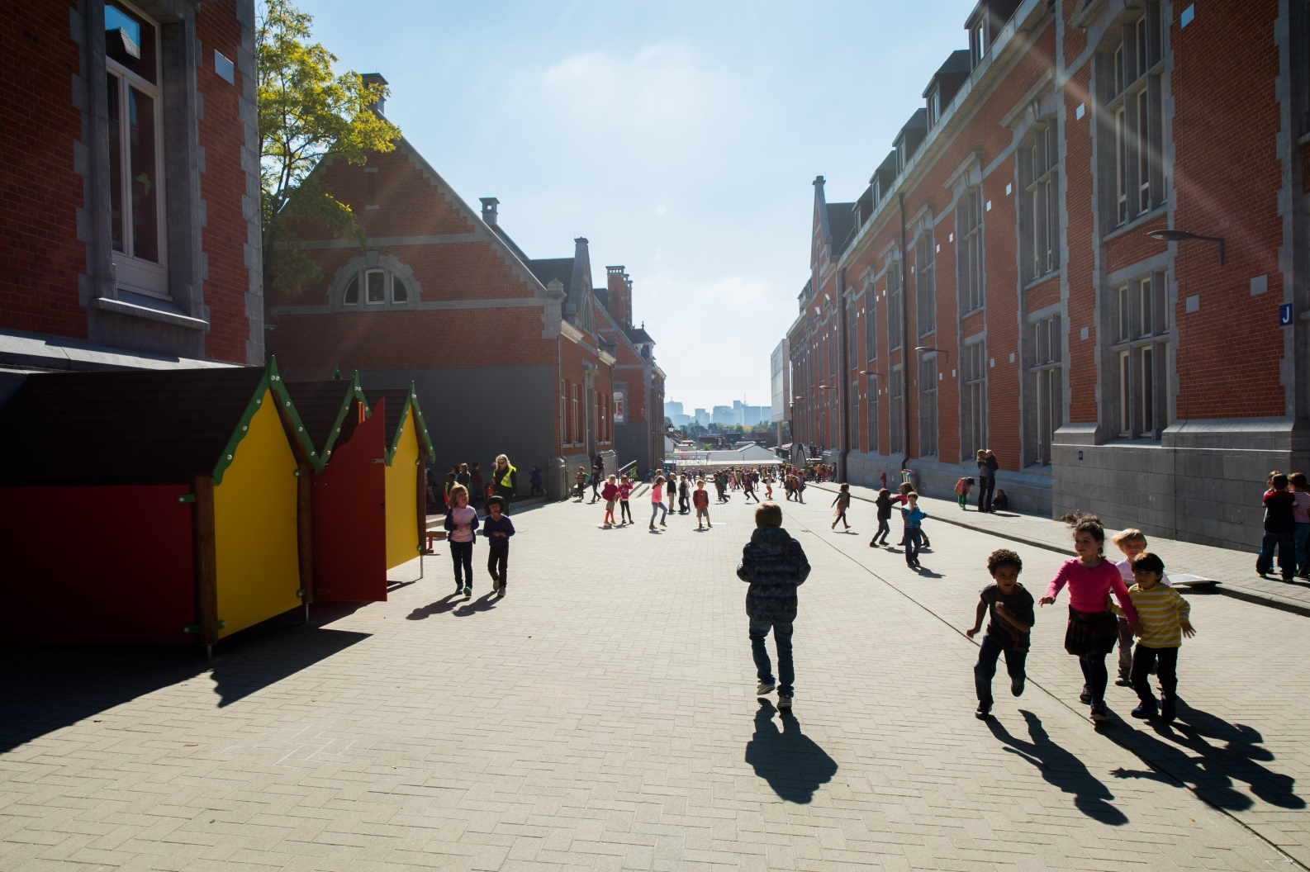
46

